Slide 1
Summer of NativeScript
July 2015

Slide 2
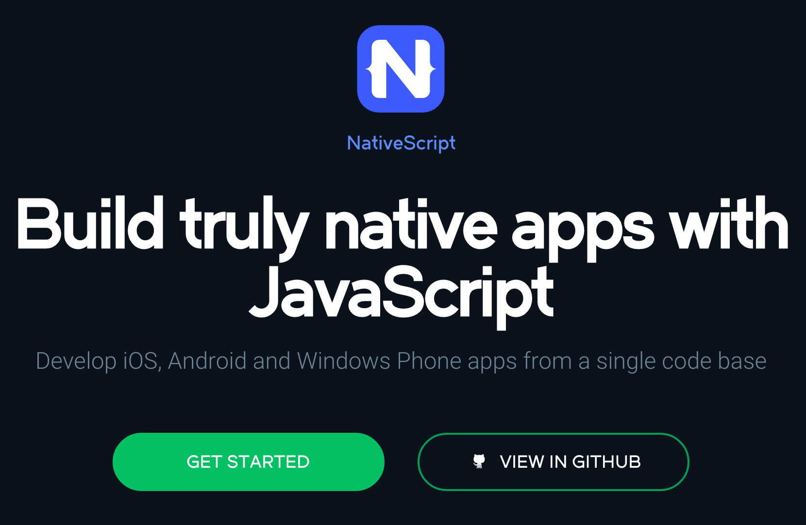
http://nativescript.org

Slide 3


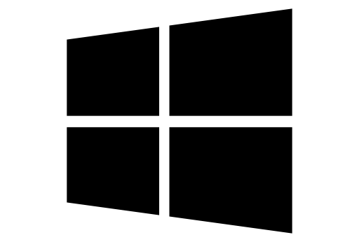
What is NativeScript?
A runtime for building and running native iOS, Android, and (soon) Windows Phone apps with a single, JavaScript code base

Slide 4


Slide 5

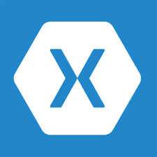


!=
!=
No DOM
No cross compilation
!=
Direct access to native APIs in JS

Slide 6
Why NativeScript?
Skills reuse
Standards-based JavaScript, CSS, optionally TypeScript
Code reuse
npm modules, 3rd-party iOS and Android libraries
Easily use native APIs
No wrappers to access native APIs
Use native UI elements
Open source!

Slide 7
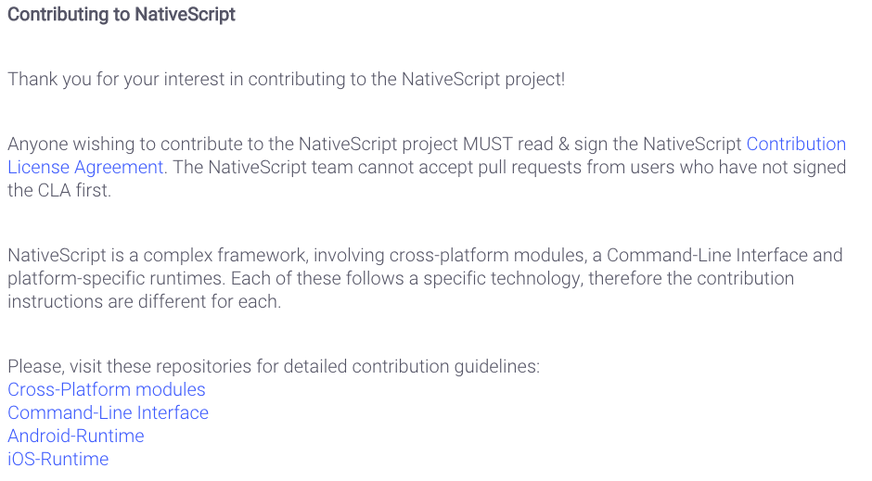
Contribute! (nativescript.org/contribute)

Slide 8





Bridge

Slide 9
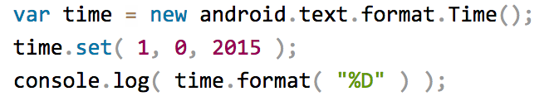
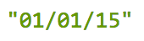
NativeScript Android example
Output:
Notes:
I'll give your brain a minute or two to parse this, because yes, this JavaScript code instantiates a Java android.text.format.Time() object, calls its set() method, then logs the return value of its format() method, which is the string "01/01/15".

Slide 10
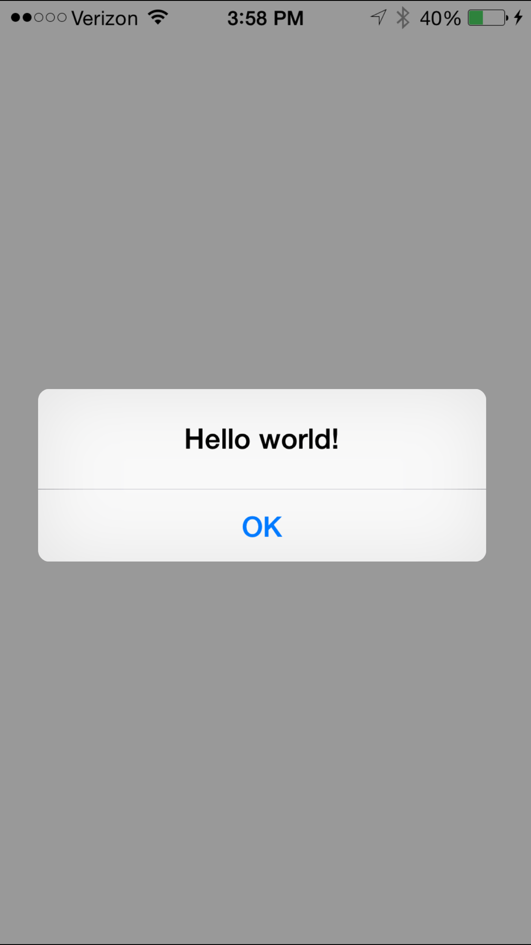
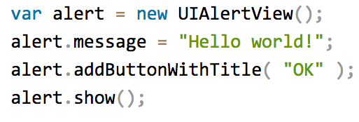
NativeScript iOS example
Notes:
This JavaScript code instantiates an Objective-C UIAlertView class, sets its message property, and then calls its addButtonWithTitle() and show() methods. When you run a NativeScript iOS app with this code you'll see the alert below:

Slide 11
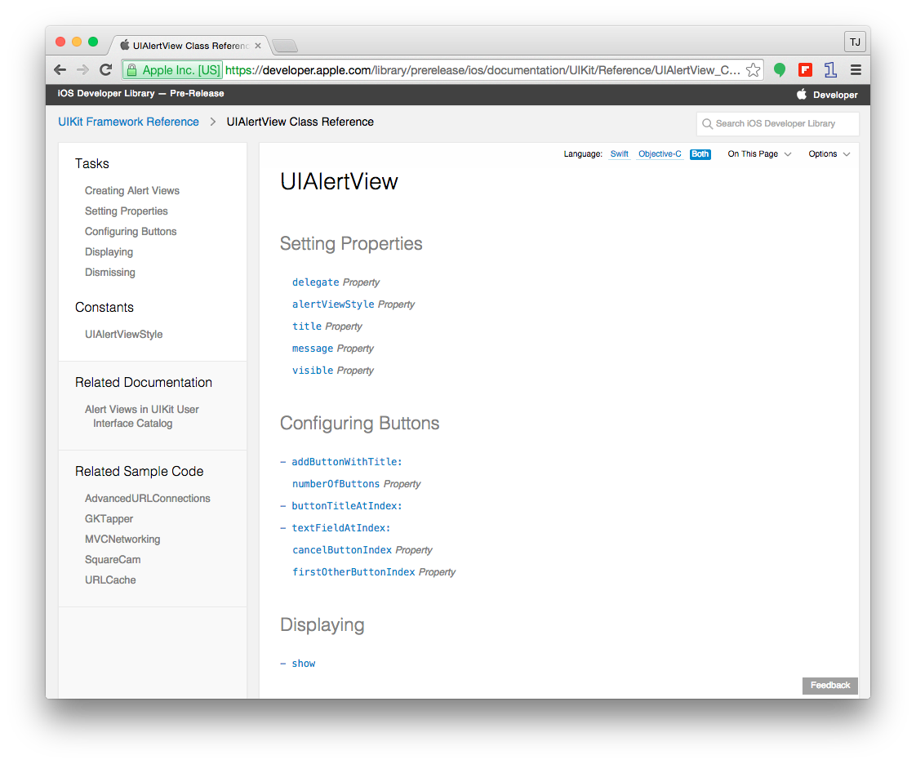

Slide 12

How does this work?

Slide 13
NativeScript and JS VMs
NativeScript runs JavaScript on a JavaScript VM
JavaScriptCore on iOS
V8 on Android

Slide 14
Runs on V8
Runs on JavaScriptCore

Slide 15
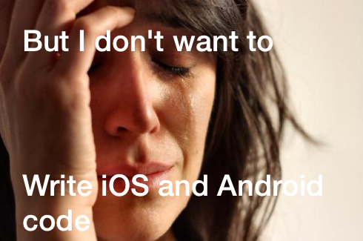

Slide 16
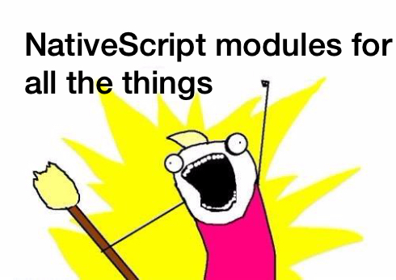

Slide 17
NativeScript modules
NativeScript-provided modules that provide cross-platform functionality.
There are dozens of them and they’re easy to write yourself.
NativeScript modules follow Node module’s conventions (CommonJS).

Slide 18
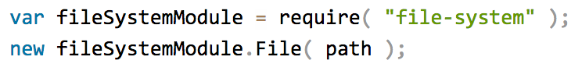
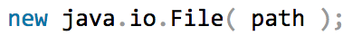
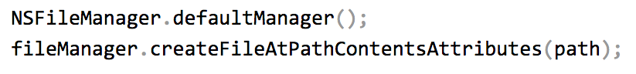
NativeScript file module

Slide 19
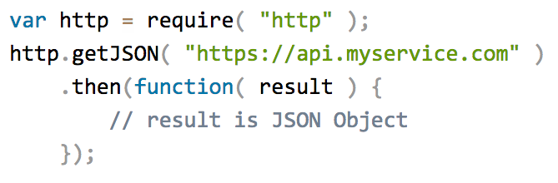
HTTP module example

Slide 20
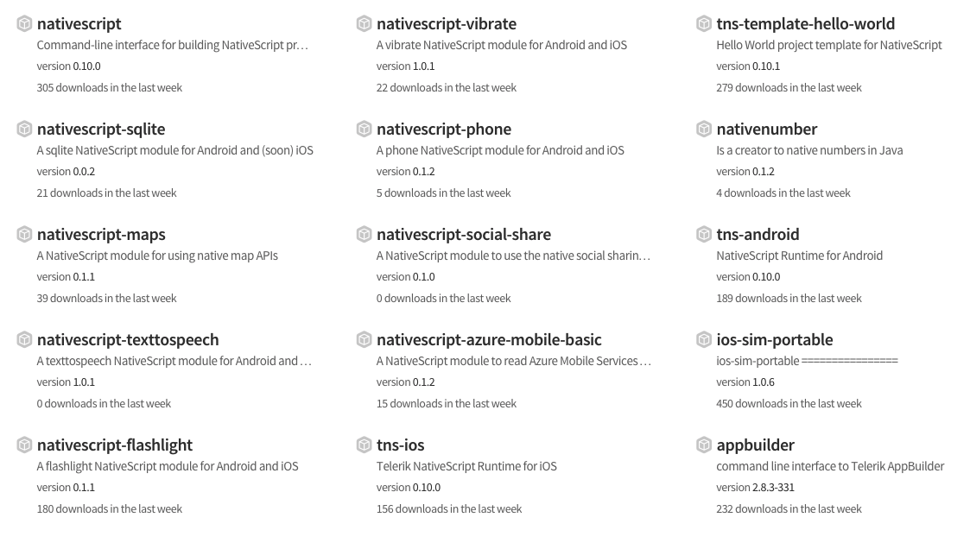
Community modules
https://www.npmjs.com/search?q=nativescript

Slide 21

But how do I turn this into an app?

Slide 22

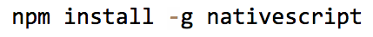
Two ways to use NativeScript
1)
2)

Slide 23
http://telerik.com/platform
Backend-as-a-service
Push notifications, cloud data, file storage, and more
Analytics
AppBuilder
Cloud builds (build iOS apps on Windows, Windows Phone apps on a Mac)
NativeScript debugging and tooling
Automated app testing
And more!

Slide 24
Telerik AppBuilder IDE Options
In-Browser Client
Visual Studio Extension
Sublime Text Package
Command-Line Interface

Slide 25
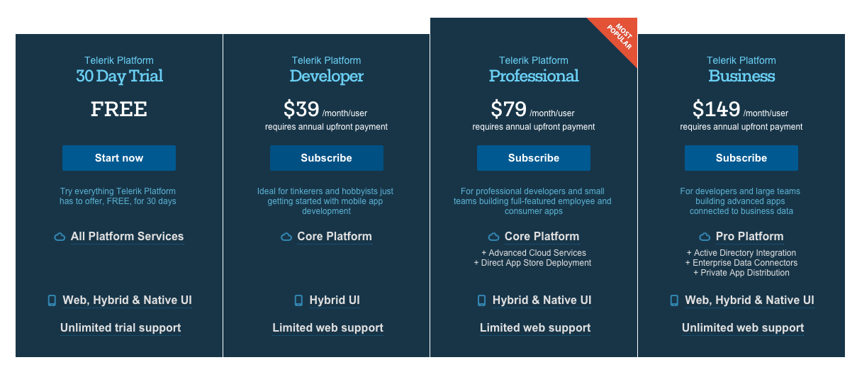
https://www.telerik.com/purchase/platform

Slide 26
NativeScript CLI
Free and open source
https://github.com/nativescript/nativescript-cli

Slide 27
NativeScript CLI requirements
https://github.com/nativescript/nativescript-cli#system-requirements
JDK, Apache Ant, Android SDK
Xcode, Xcode CLI tools, iOS SDK

Slide 28
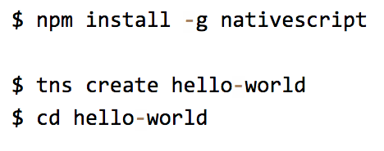
Starting a new project

Slide 29
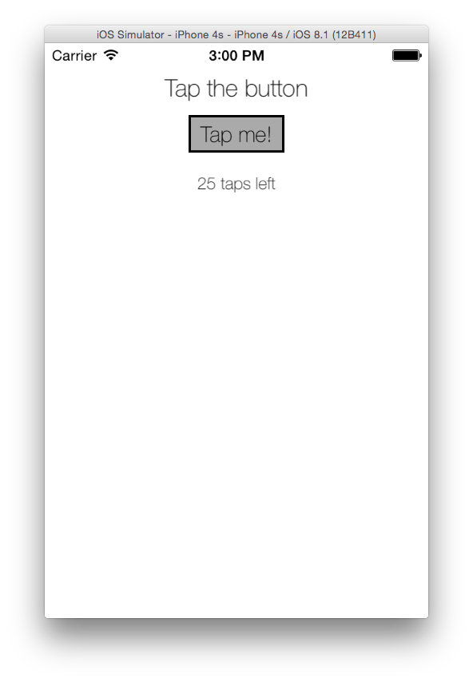
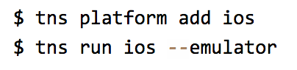
Running on iOS

Slide 30
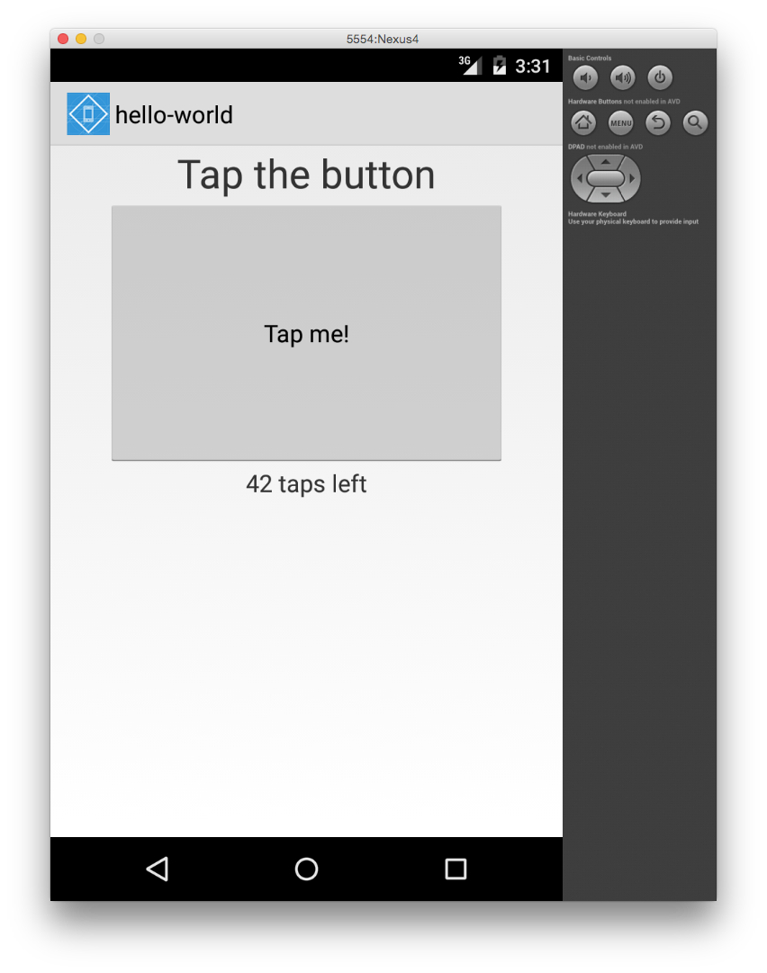
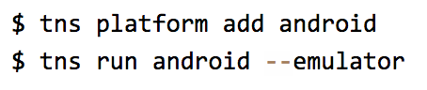
Running on Android

Slide 31
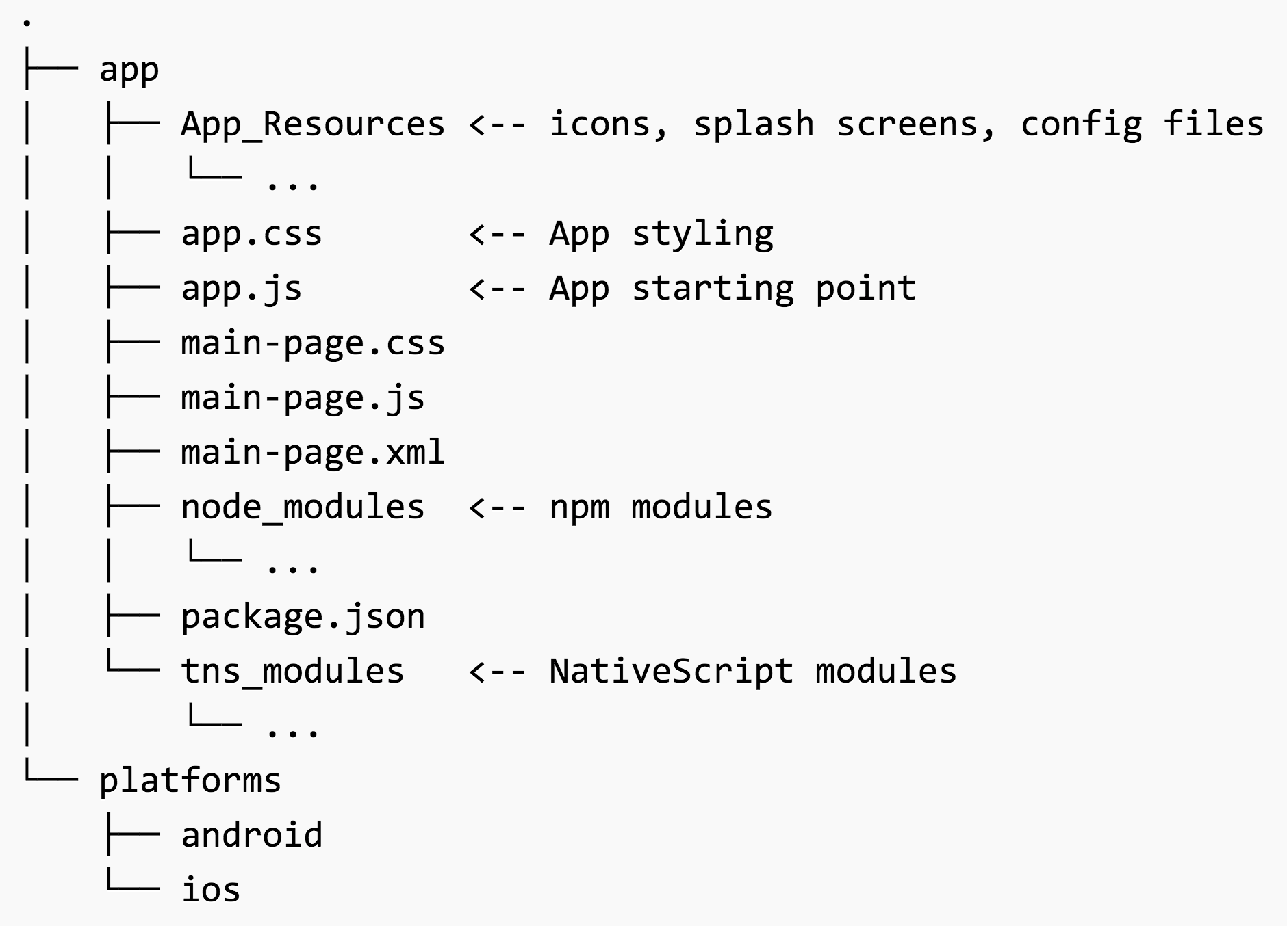

Slide 32
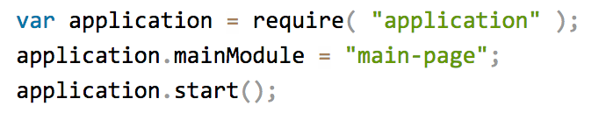
app.js

Slide 33
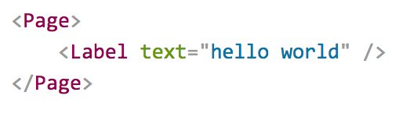
Pages
XML markup structure
Elements (e.g. <Page>, <Label>) are NativeScript modules

Slide 34
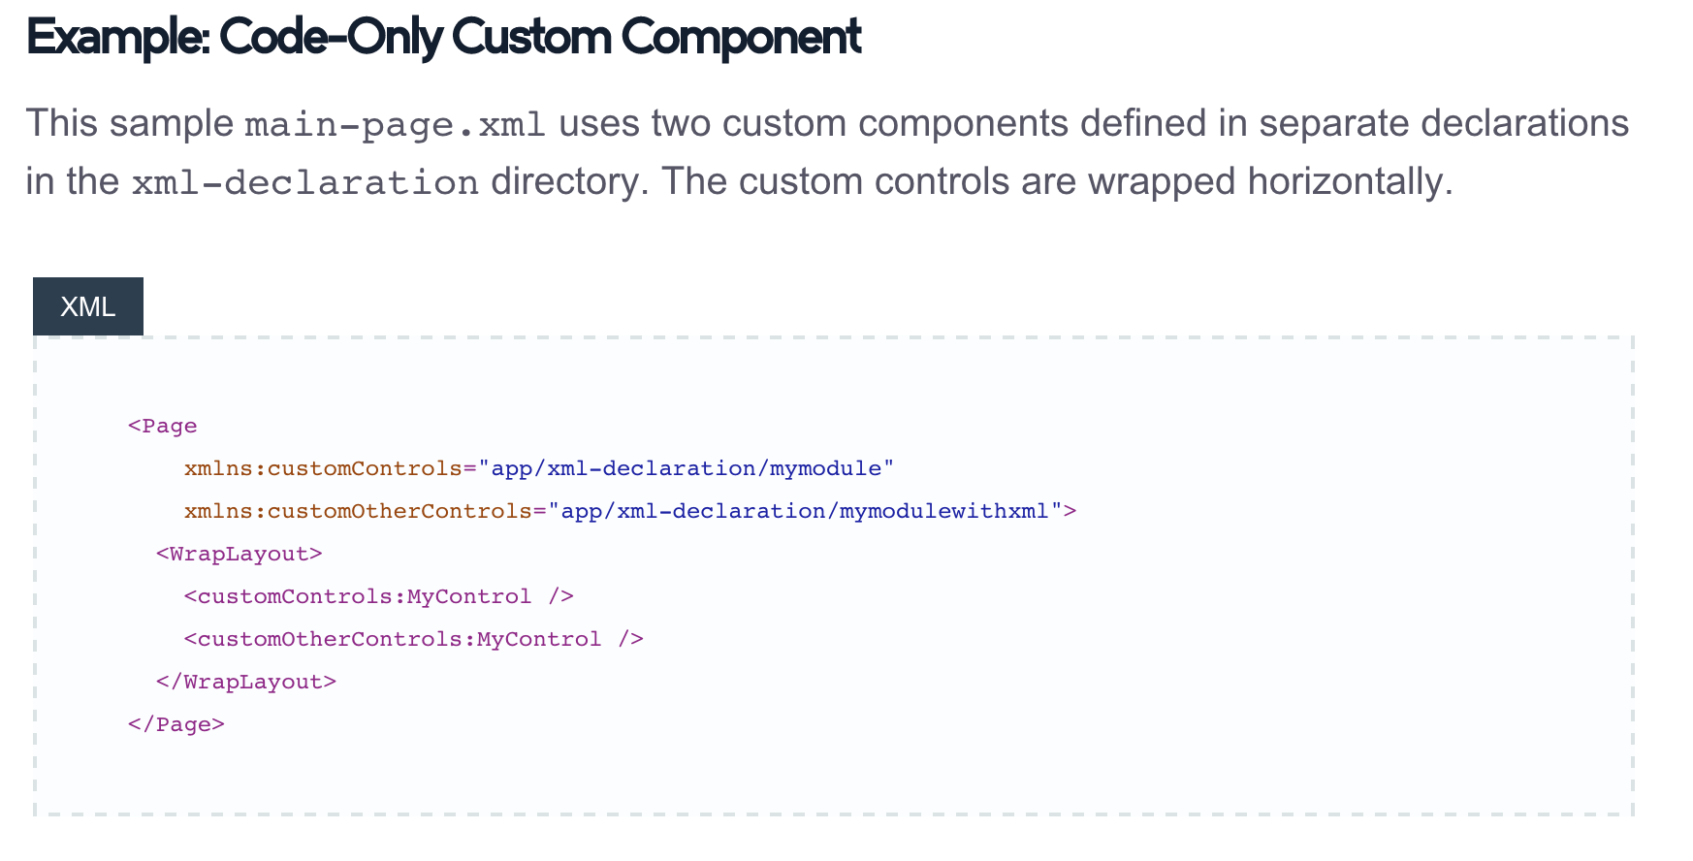
Custom XML Components
http://docs.nativescript.org/ui-with-xml#custom-components

Slide 35
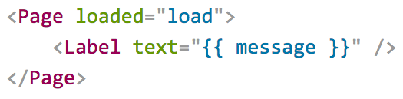
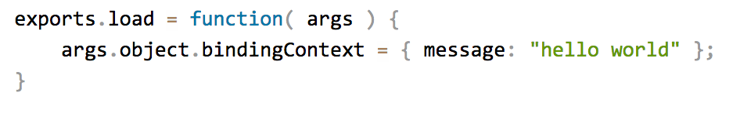
Data binding

Slide 36
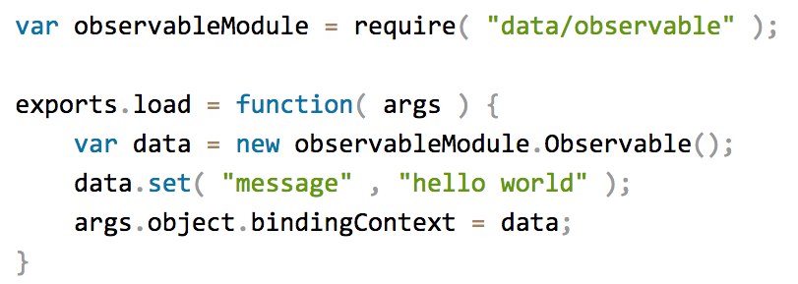
Data binding improved

Slide 37
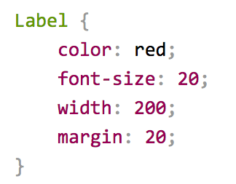
CSS

Slide 38
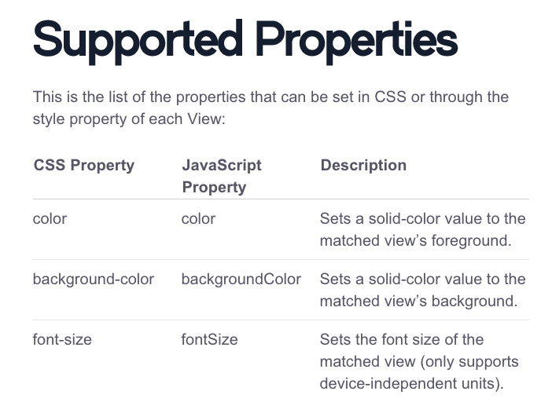
http://docs.nativescript.org/styling#supported-properties

Slide 39


Slide 40
Hands-on Lab
https://github.com/tjvantoll/summer-of-nativescript/blob/master/july/lab.md

Slide 41
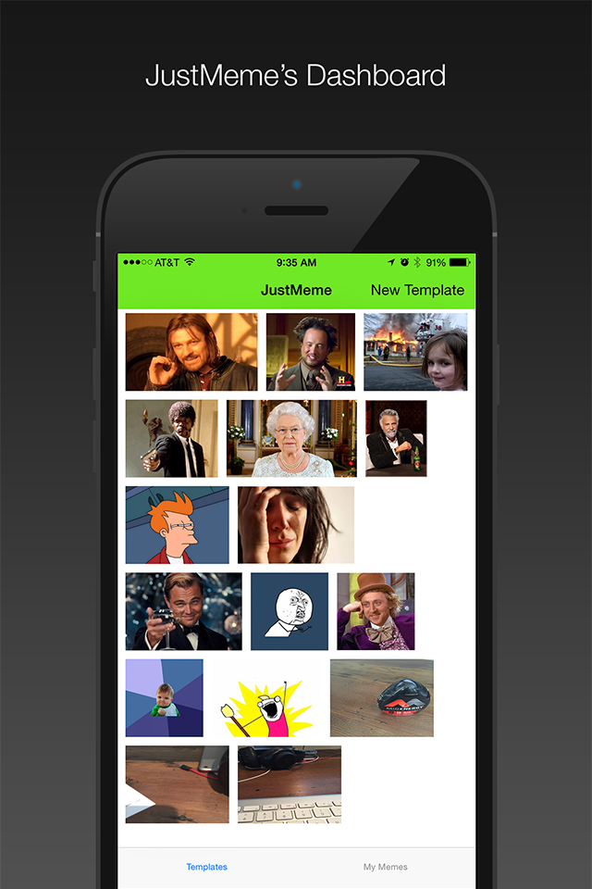

JustMeme
https://github.com/NativeScript/sample-JustMeme

Slide 42
Follow NativeScript
nativescript.org
@nativescript
nativescript.org/blog

